Slide 1
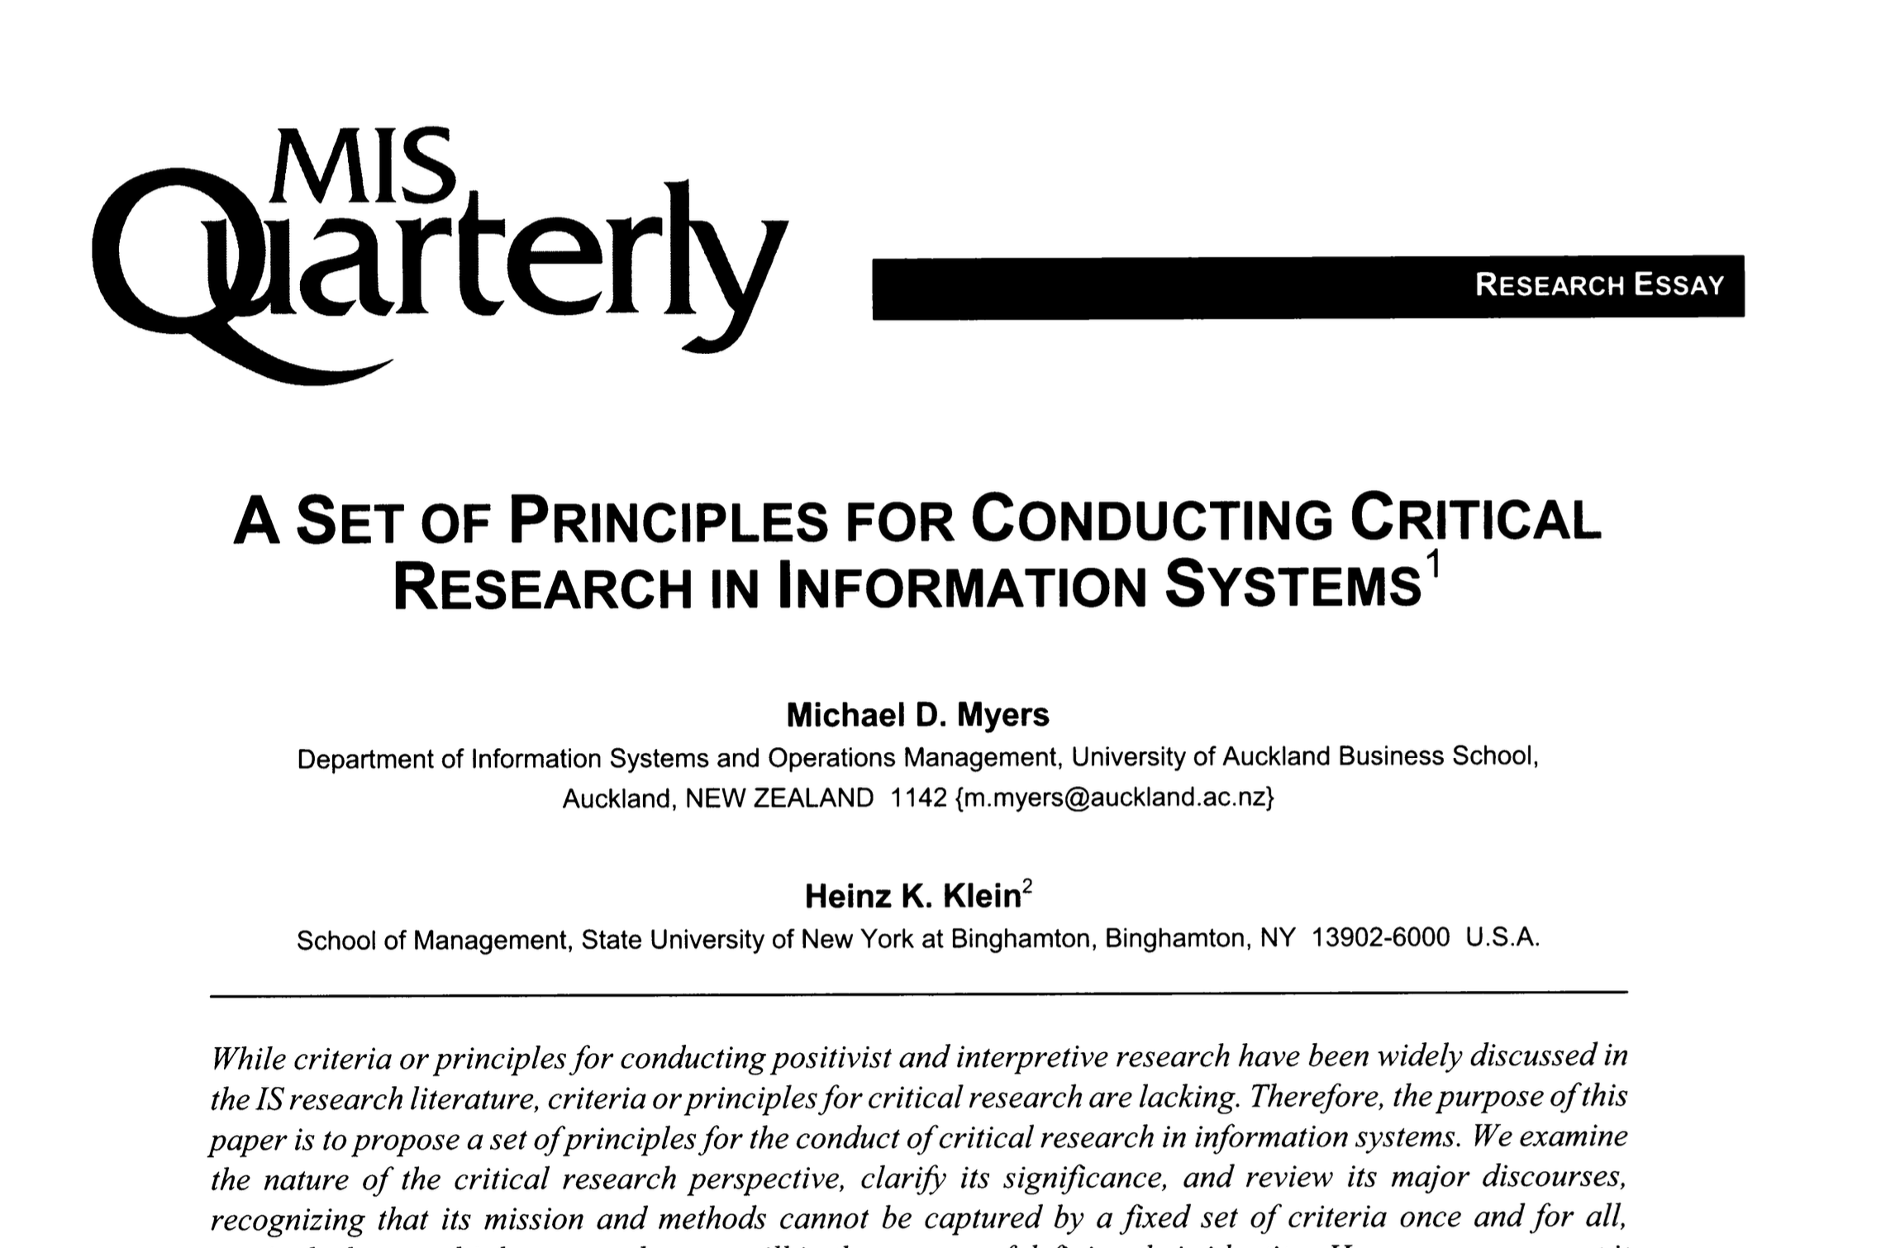

Slide 2




Slide 3
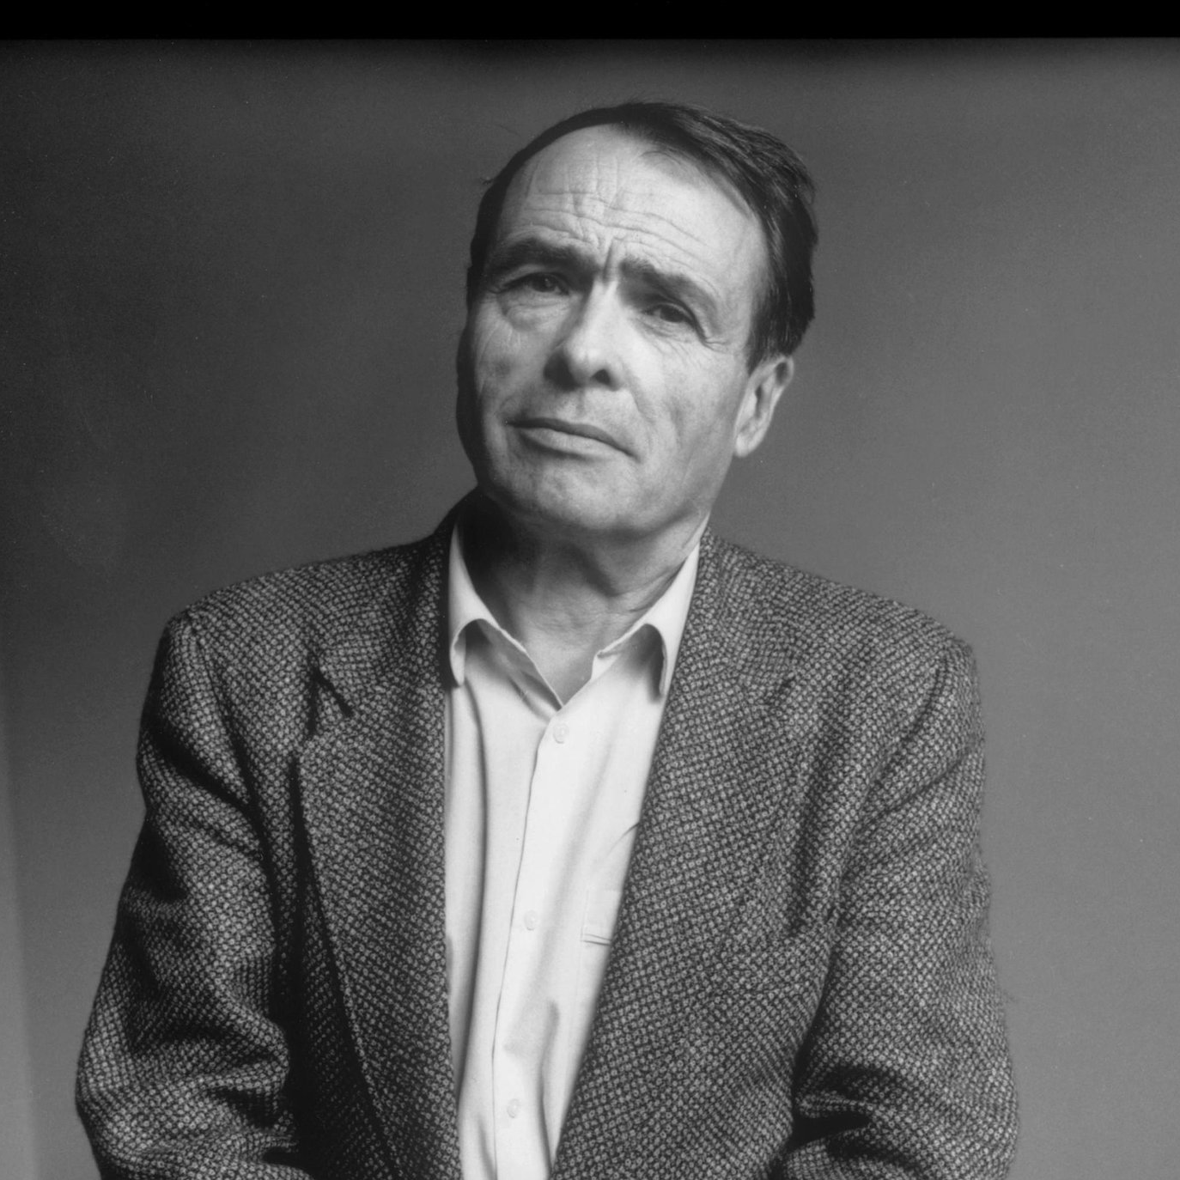
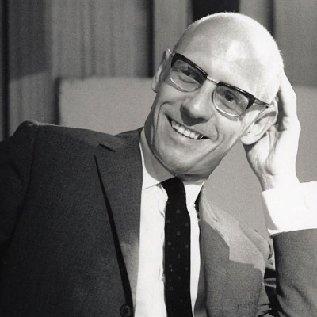
Pierre Bourdieu
1930—2002
Michel Foucault
1926—1984
Notes:
Bourdieu image source: https://www.nytimes.com/2017/07/18/opinion/inequality-pierre-bourdieu.html
Foucault image source: https://contemporarythinkers.org/michel-foucault/biography/

Slide 4
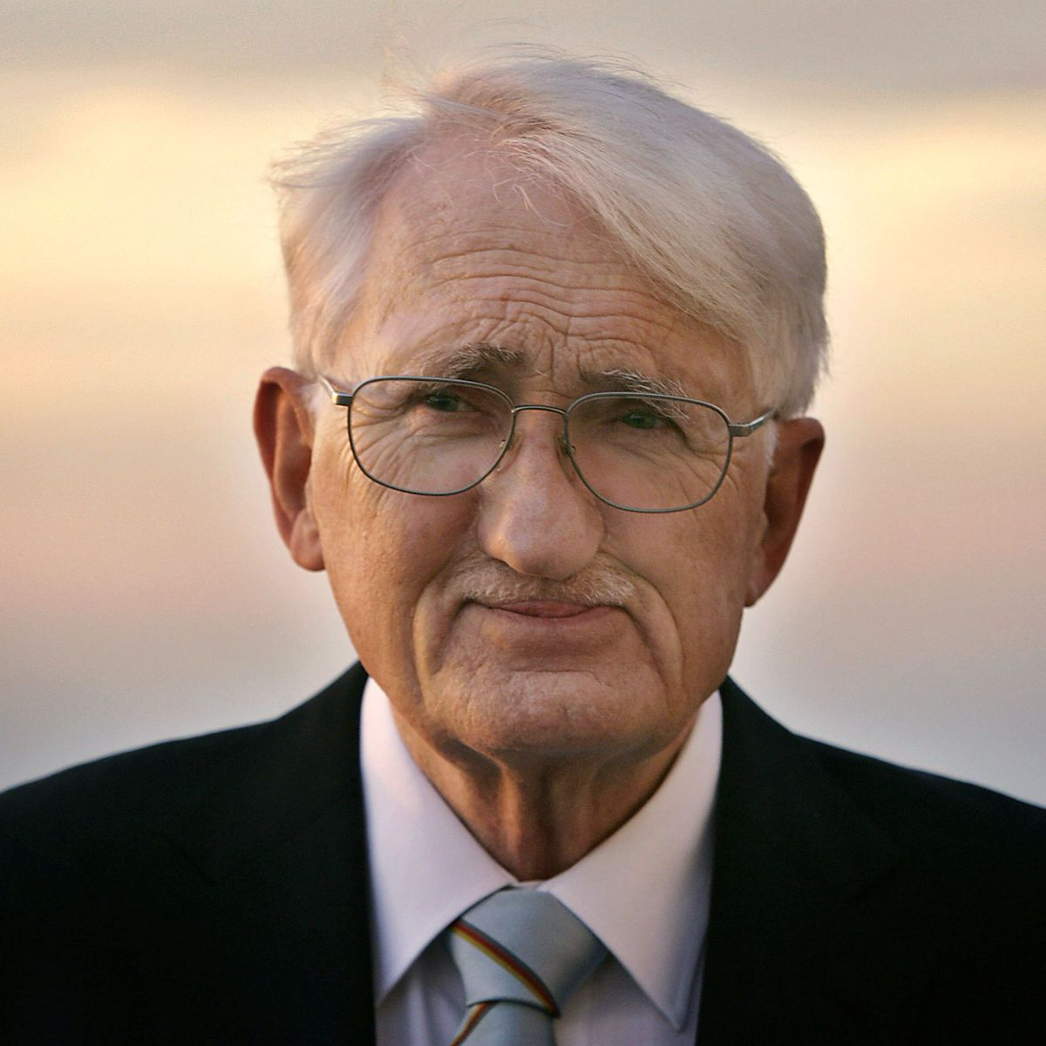
Jürgen Habermas
1929—

Slide 5
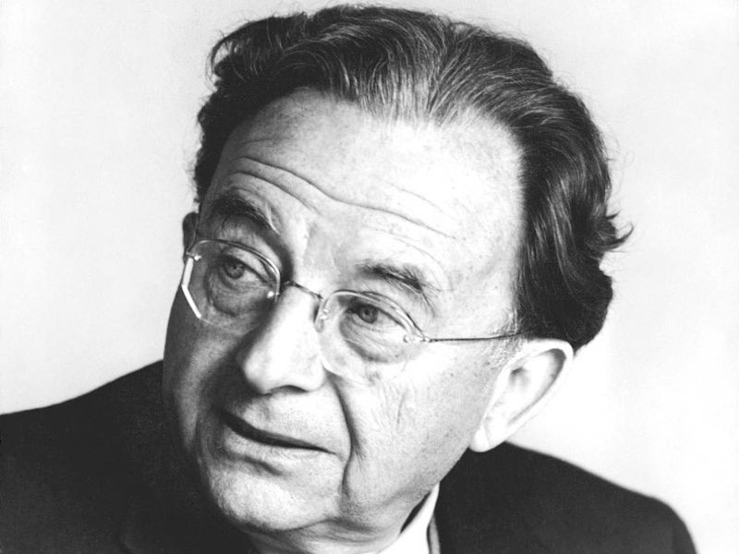
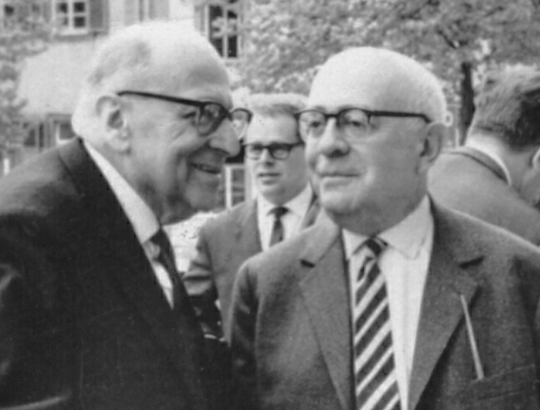
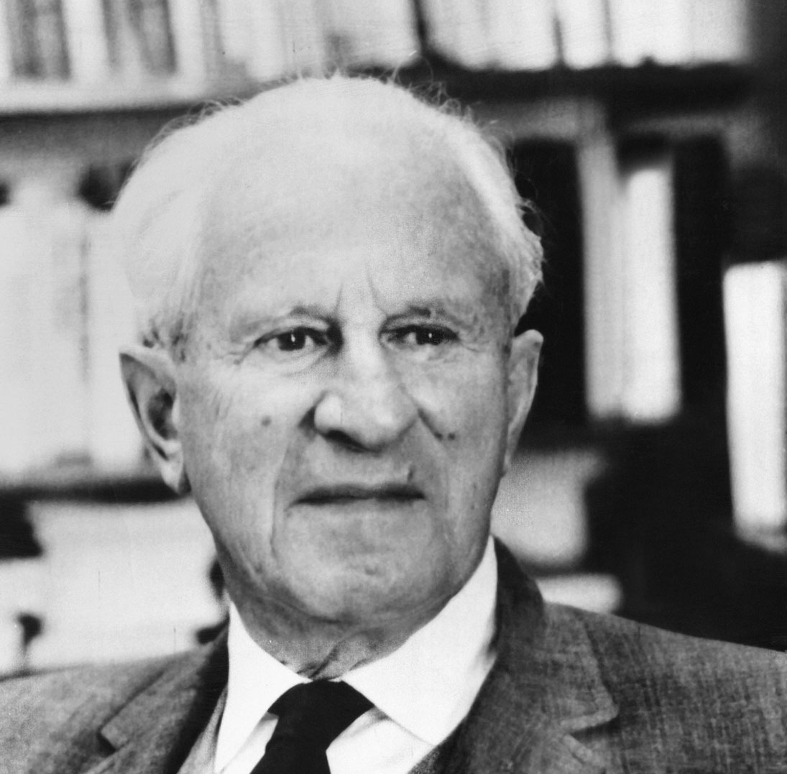
Erich Fromm 1900—1980
Max Horkheimer 1895—1973
Theodor Adorno 1903—1969
Herbert Marcuse 1898—1979

Slide 6



